Slide 1
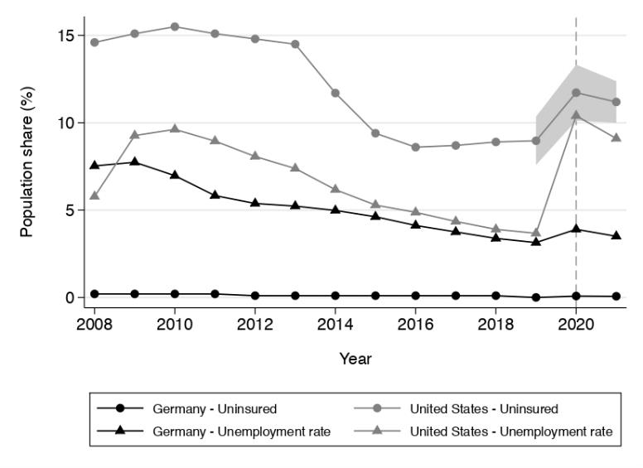
Covid as revelator

Slide 2
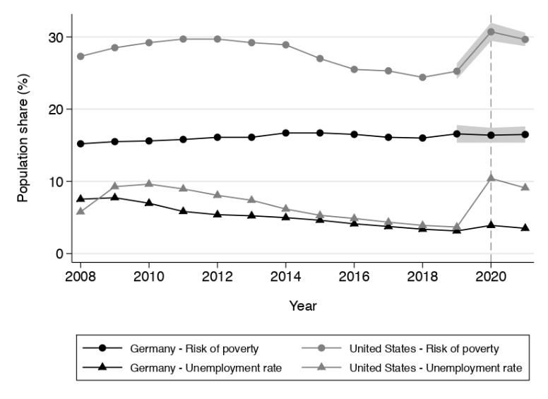
Covid as revelator

Slide 3
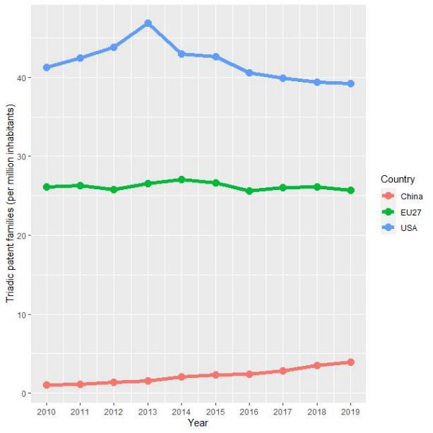
Covid as revelator
Triadic patents (per million inhabitants)

Slide 4
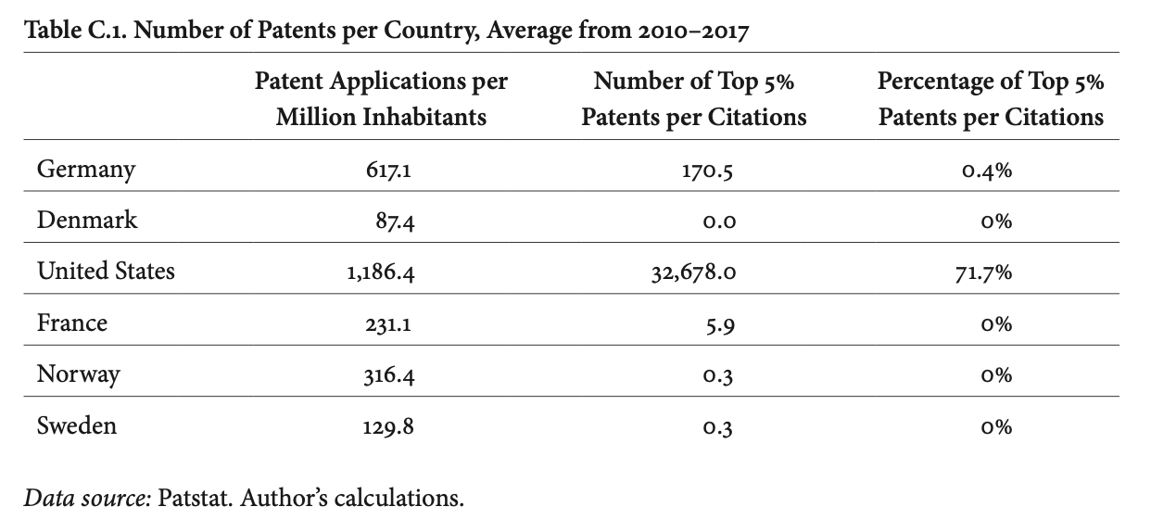

Slide 5
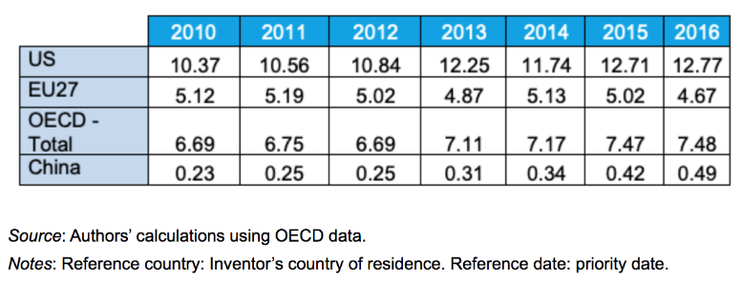
Covid as revelator
Brevets en biotechnologies (pour 1 million d’habitants)

Slide 6
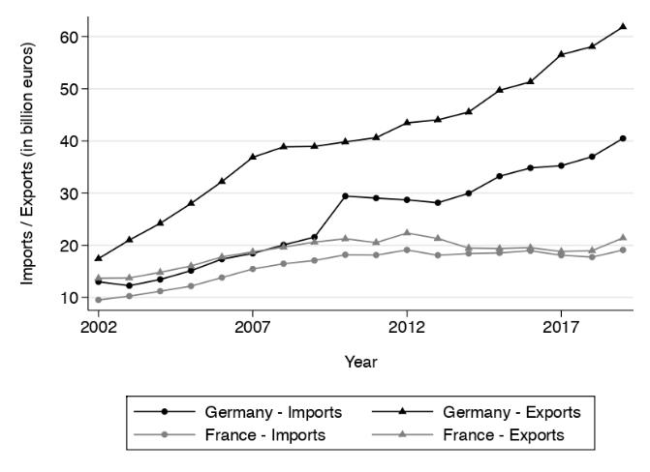
Evolution of imports and exports of products intended for the fight against Covid-19

Slide 7
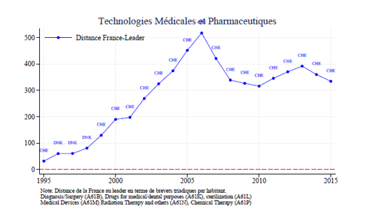
Medical and pharmaceutical technologies

Slide 8
Education

Slide 9
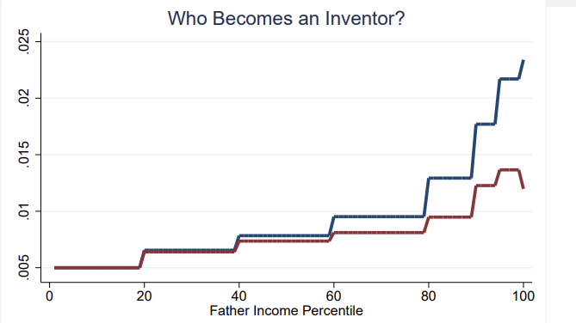
Education

Slide 10
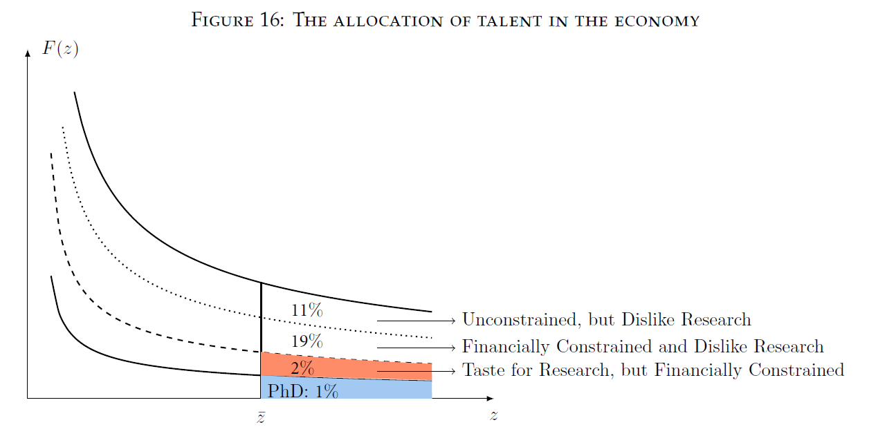
Akcigit et al, 2020
Deux limites à l’accession au doctorat par les plus talentueux …
Le coût des études privent certains de l’obtention d’un doctorat (revenus familiaux insuffisants)
Le manque d’attractivité des métiers de la recherche (salaires, préférences…)

Slide 11
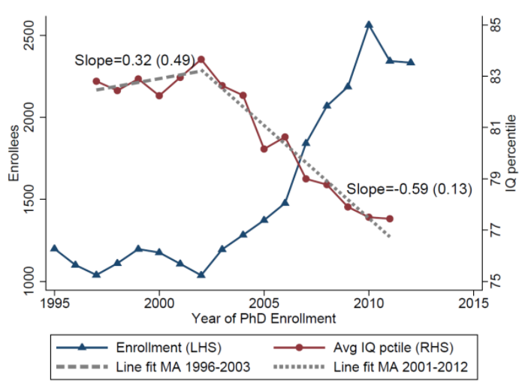
Akcigit et al, 2020
Fait 9: Un arbitrage, nombre de chercheurs vs qualité des chercheurs
Plus le nombre de doctorants augmente, plus leur QI moyen diminue…

Slide 12
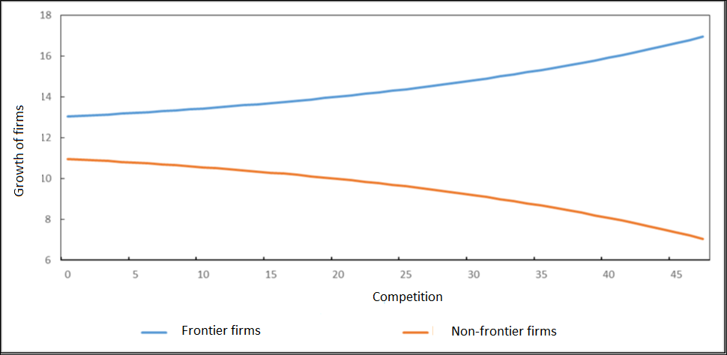
Competition, growth and distance to frontier

Slide 13
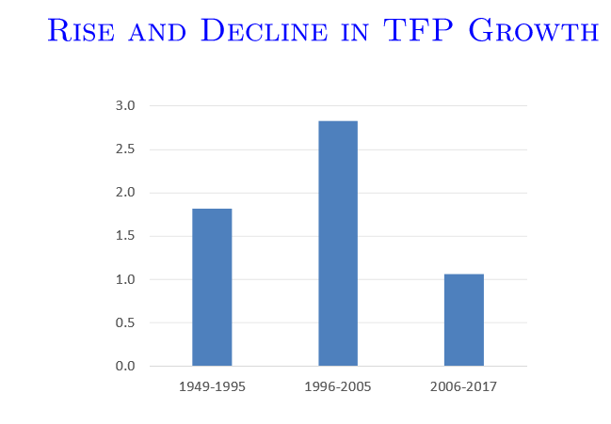

Slide 14
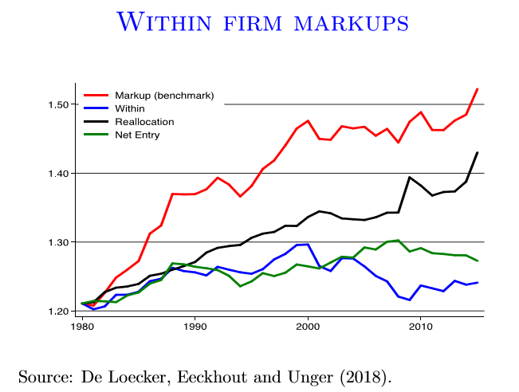

Slide 15
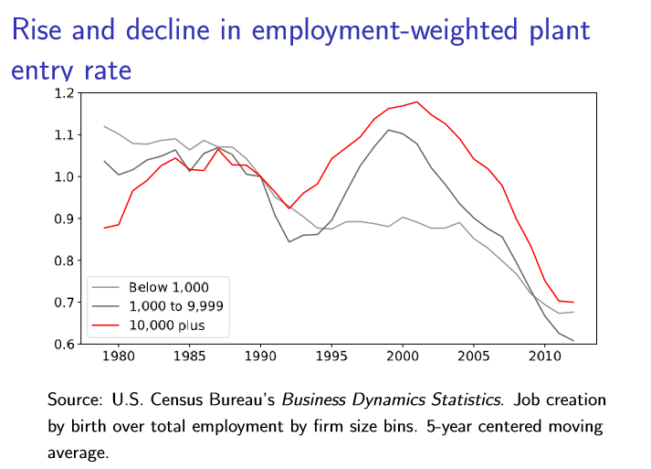

Slide 16
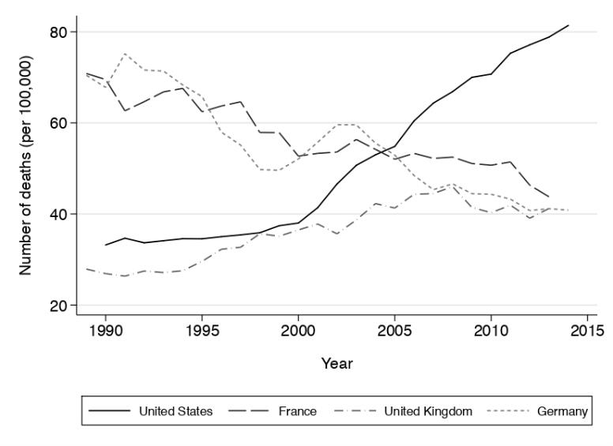
Flexsecurity
Source: Case and Deaton (2017).

Slide 17
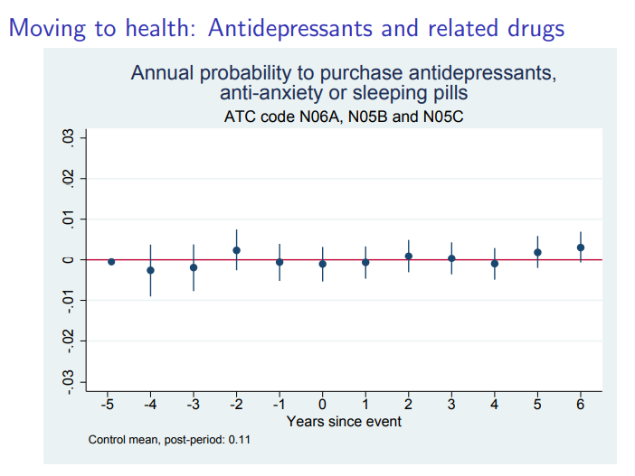
Alexandra roulet on denmark

Slide 18
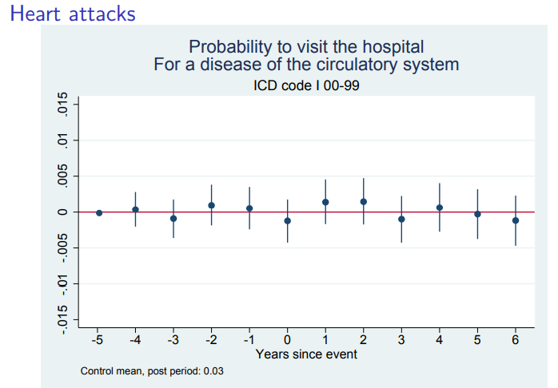
Alexandra roulet on denmark

Slide 19
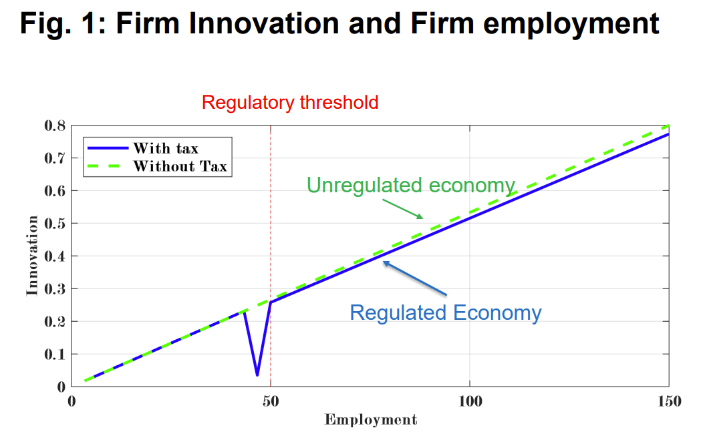

Slide 20
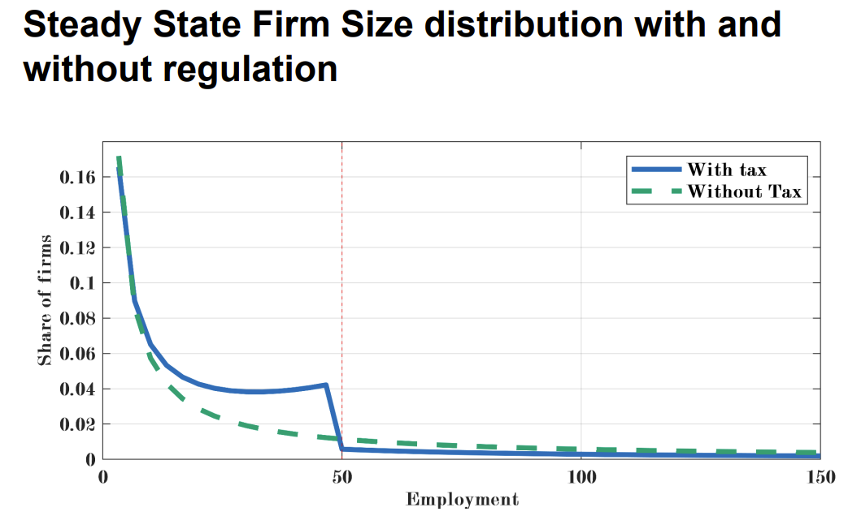

Slide 21
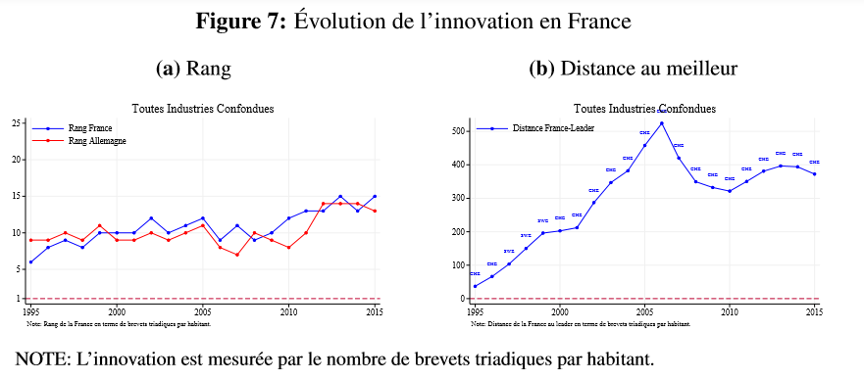

Slide 22
Covid as revelator
Financing from BARDA to fight COVID-19

Slide 23
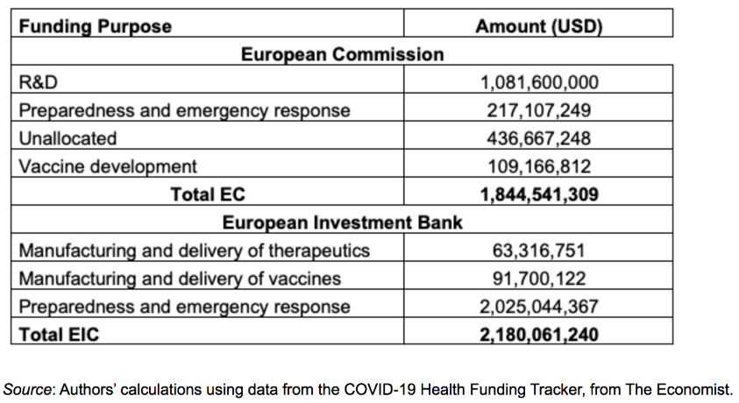
Covid as revelator
Financing from the European Commission and the European Investment Bank
Mesures de la BARDA pour lutter contre le COVID-19

Slide 24
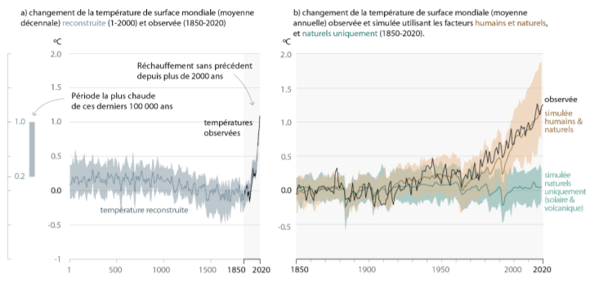
Surface temperature compared to the average of the period 1850-1900
Face au changement climatique
Source : GIEC (2021)

Slide 25
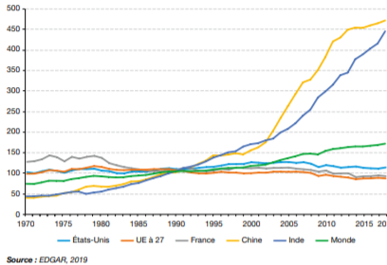
Evolution of CO2 emissions worldwide between 1970 and 2018 – Base 100 index in 1990
Face au changement climatique

Slide 26
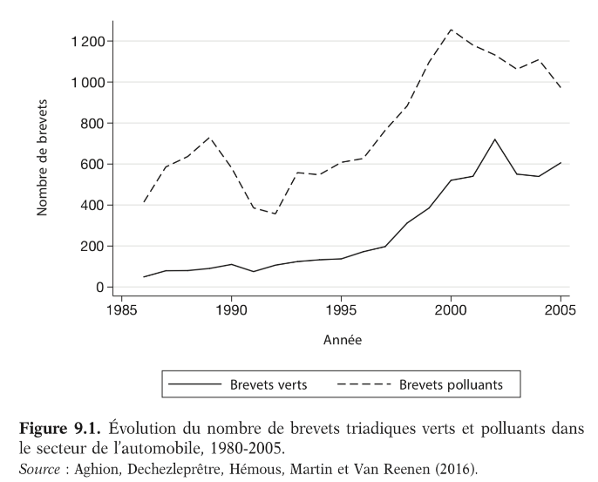
Clean versus dirty patents

Slide 27
EVOLUTION OVER TIME OF Clean/dirty/grey car related innovations (Aghion et al. 2020)
(a) Absolute number of innovations
Source: PATSTAT. Patents are classified based on the IPC and Y02 classification systems.

Slide 28
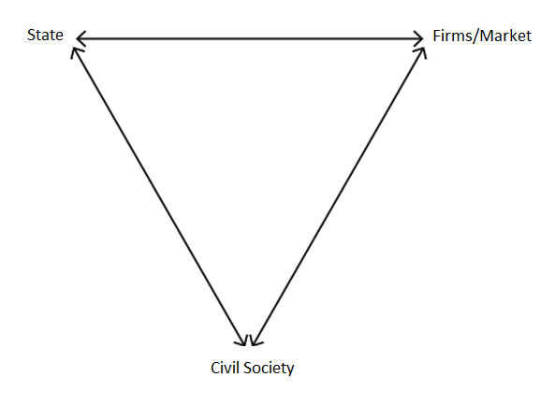
Rethink capitalism
Magic triangle: Firms/Market – State – Civil Society (Bowles and Carlin):
Notes:
• COVID • Ensure stronger, greener, and fairer growth

